Slide 1

Data Visualization Pitch
Global Burden of Disease to SDI Analysis: Socio-Demographic Index Trends (1950–2021)
Author: Abdul Sami
Image source: Africa Rivista, C. Forlenza - “La guerra in Sudan e il ruolo nascosto dei mercenari colombiani”, 8 feb. 2025.

Slide 2
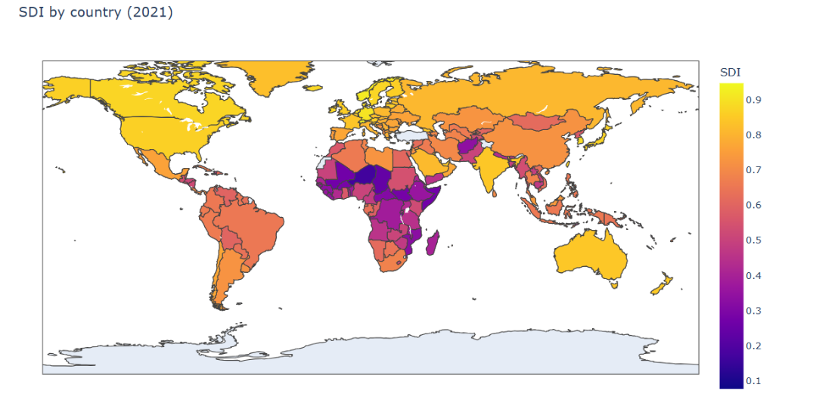
Data Visualization Pitch
Abdul Sami
Matricola:939542
How has global and Italy’s Socio-Demographic Index (SDI) evolved from 1950 to 2021?
This analysis examines the evolution of the Socio-Demographic Index (SDI) from 1950 to 2021, using data from the IHME Global Burden of Disease Study 2021. Through a comparative and regional approach, the research focuses on global trends as well as Italy’s trajectory, highlighting the social, educational, and economic factors that have shaped human development over the past seven decades. The analysis provides insights into disparities, relative progress, and long-term development patterns across countries and regions
Author: Abdul Sami
E-mail:
a.sami7@campus.unimib.it

Slide 3
Questions
This analysis aims to explore the long-term evolution of Socio-Demographic Index (SDI) levels across countries and Italy from 1950 to 2021, connecting quantitative development patterns with the broader global social, economic, and demographic context.
          The key research questions guiding the project are:
                How has global SDI evolved from 1950 to 2021?
                How does Italy’s SDI trajectory compare with global and regional peers?
                Which countries or regions contributed most to changes in global SDI?
                Which countries or regions contributed most to changes in global SDI?
                What long-term social and demographic factors might explain Italy’s SDI trends?
                How persistent and stable is Italy’s development progress over the decades?
                Which periods in Italy’s SDI history show notable acceleration or stagnation, and what social or policy factors could explain these shifts?
                How evenly has development progressed across years in Italy, and are there periods of unusually high or low SDI variation?
                Does Italy’s long-term SDI trend indicate steady growth, and how does this compare to global development benchmarks?
                How consistently does Italy outperform or underperform its peer group, and what lessons can be drawn about the stability of its development?

Slide 4
About the DATA
Dataset: Global Burden of Disease Study 2021 (Dataset )
GitHub : Project All Martial and Report(Github)
The dataset used in this project comes from the Global Burden of Disease Study 2021 (GBD 2021), published by the Institute for Health Metrics and Evaluation (IHME). It provides annual Socio-Demographic Index (SDI) values for 204 countries and territories from 1950 to 2021.
SDI is a composite indicator that summarizes a country’s development level using three normalized metrics:
Education level (mean years of education among people aged 15+)
Income per capita (lag-distributed income)
Fertility rate under age 25
The three dimensions are combined using a geometric mean, producing a value between 0 (lowest development) and 1 (highest development).
It is well-structured and easily usable, and the dataset is already pre-processed

Slide 5
Insights from the Data
The following analysis examines the evolution of the Socio-Demographic Index (SDI) from 1950 to 2021. The SDI, developed by the Institute for Health Metrics and Evaluation (IHME), combines measures of income per capita, average educational attainment, and fertility rates to provide a summary measure of development status across countries and regions.
From a methodological perspective, the analysis was conducted using Python, (Pandas, Matplotlib, Seaborn) leveraging:
Time series analysis to represent the SDI trend from 1950 to 2021.
Normalization and scaling to facilitate comparisons across countries and regions, regardless of absolute SDI values;
Data visualization (line charts, regional comparisons) to identify patterns, peaks, and periods of stagnation or growth.
This method allows us to highlight:
The overall level and evolution of SDI at the global, regional, and national (Italy) levels;
Periods of accelerated or slower development, and how they relate to long-term social, demographic, and economic factors;
How Italy’s SDI trajectory compares with global and regional peers, showing both convergences with more developed countries and deviations during specific historical periods.

Slide 6
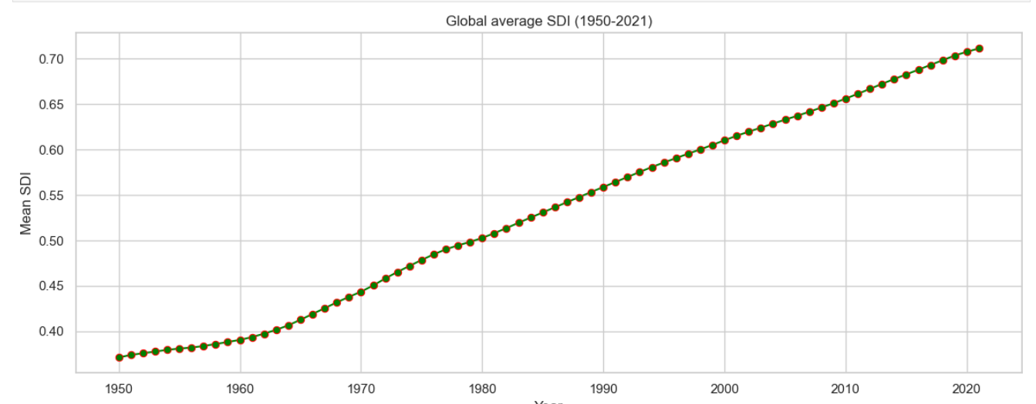
Global Trends in SDI (1950–2021)
1950 – 1965 Early Post Was Improvement
The global SDI begins at relatively low levels but shows a steady, gradual rise. Most countries expand basic education, reduce child mortality, and rebuild essential public services. Growth is stable but moderate, reflecting early post-war recovery rather than acceleration.
1965–1980 Accelerated Social Progress
The slope of the curve increases as many countries undergo demographic transition falling fertility rates, expanding primary education, and improvements in healthcare systems. This period marks the first global shift toward medium SDI levels.
1980–2021 Continuous Global SDI Advancement
From 1980 onward, global SDI shows steady, uninterrupted growth, driven by rapid modernization in political and social and expanded access to education and healthcare worldwide.
Emerging economies in regions accelerate this progress, pushing global SDI to its highest recorded levels by 2021, reflecting broad and sustained improvements across most of the world.
“Global Sustainable Development Index (SDI), 1950–2021” by Abdul Sami, based on dataset from the Institute for Health Metrics and Evaluation (IHME). Under the Free-of-Charge Non-Commercial User Agreement.
Why chosen: Because the Line charts are best for showing long-term time trends and development direction.

Slide 7

Global SDI Landscape (2021)
High-Development Belt Europe, North America, East Asia, Oceania
                Countries in these regions show the highest SDI values, driven by long-standing investments in education, healthcare, and demographic stabilization. They form a continuous zone of very high social development.
Upper-Middle Cluster Latin America, Eastern Europe, Middle East
These regions demonstrate substantial progress, achieving strong improvements in literacy, life expectancy, and social infrastructure.
SDI levels are rising but not yet at Western European or East Asian levels.
Lower-Development Regions South Asia and Sub-Saharan Africa
Many countries remain in the lower SDI tier due to persistent challenges such as poverty, political instability, limited public services, and high fertility rates.
These zones show the widest gap from global leaders.
“SDI World Map (2021)” by Abdul Sami, based on dataset from the Institute for Health Metrics and Evaluation (IHME). Under the Free-of-Charge Non-Commercial User Agreement.
Why chosen:A world map is the most intuitive way to display spatial development patterns and regional inequalities across countries at a global scale.
The map highlights strong geographic inequality: while many regions advanced rapidly, others continue to lag behind due to structural pressures and conflict.

Slide 8
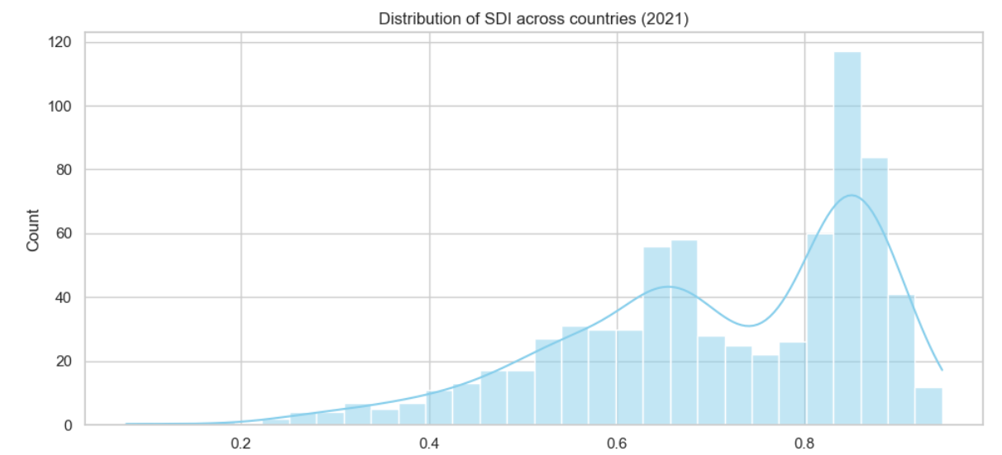
SDI Spread Across Countries (2021)
Mid-to-Upper Concentration Majority of Countries
Most nations fall into the middle and high-middle SDI brackets, showing global progress and reduced severe underdevelopment.
Right-Skewed Pattern Few Very Low Values
A long tail on the low end reveals a small group of countries still facing deep socioeconomic challenges
Smooth, Unimodal Shape Rising Global Uniformity
The KDE curve shows SDI values clustering more tightly than in previous decades, suggesting partial global convergence.
Emerging Insight Progress with Remaining Fragility
While many countries improved substantially, pockets of low development persist, creating a polarized but improving global landscape.
“Distribution of SDI (2021)” by Abdul Sami, based on dataset from the Institute for Health Metrics and Evaluation (IHME). Under the Free-of-Charge Non-Commercial User Agreement.
Why chosen: This visualization highlights global inequality and the spread of SDI values.

Slide 9
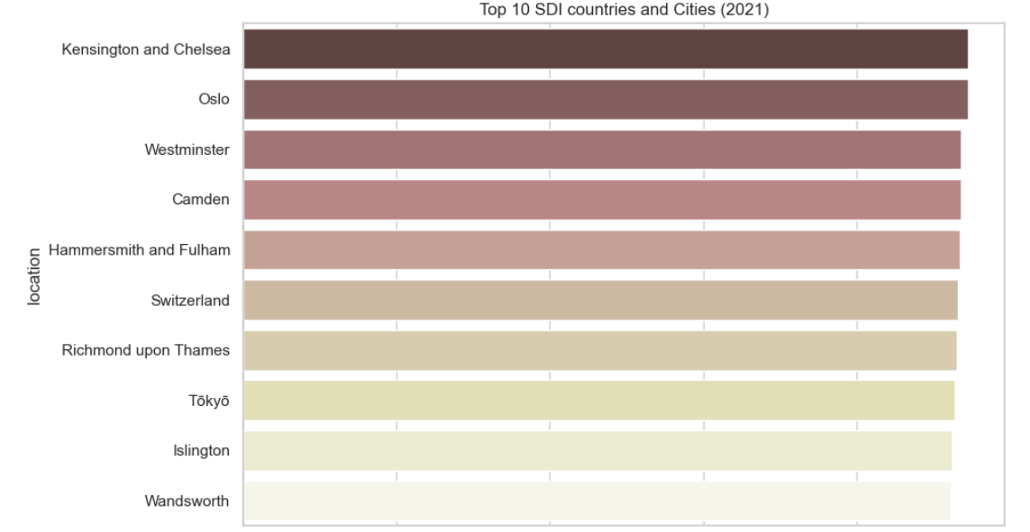
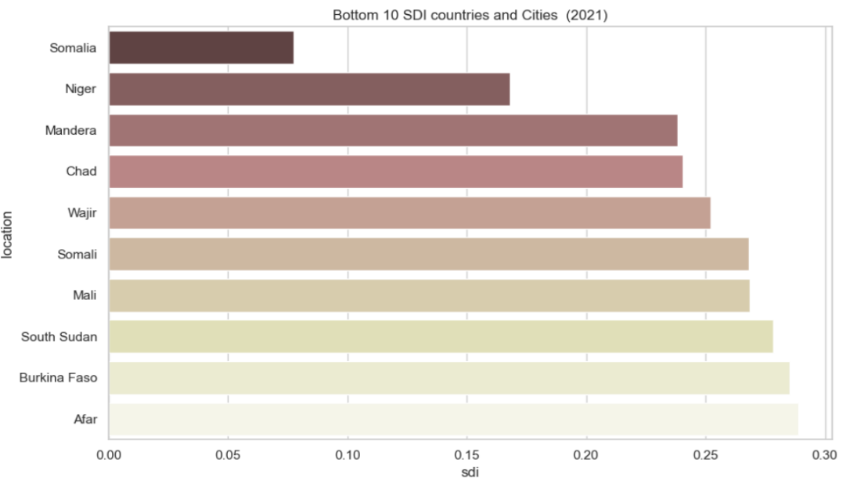
Top vs Bottom 10 SDI Countries (2021)
Top Performers Advanced Economies
High-SDI countries and Cities are dominated by long-established welfare states with robust education systems, stable institutions, and strong healthcare access.
Mid-20th Century Foundations Long-Term Investment
These countries have benefited from decades of demographic transition, infrastructure expansion, and economic stability.
Bottom Performers Fragile & Conflict-Affected States
Countries and cities at the lowest SDI levels often face wars, political crises, low schooling rates, and weak governance structures that inhibit long-term development.
Why chosen: Bar charts clearly compare cumulative SDI growth between countries.
“Global Extremes in Social Development ” by Abdul Sami, based on a dataset from the Institute for Health Metrics and Evaluation (IHME). Under the Free-of-Charge Non-Commercial User Agreement.

Slide 10
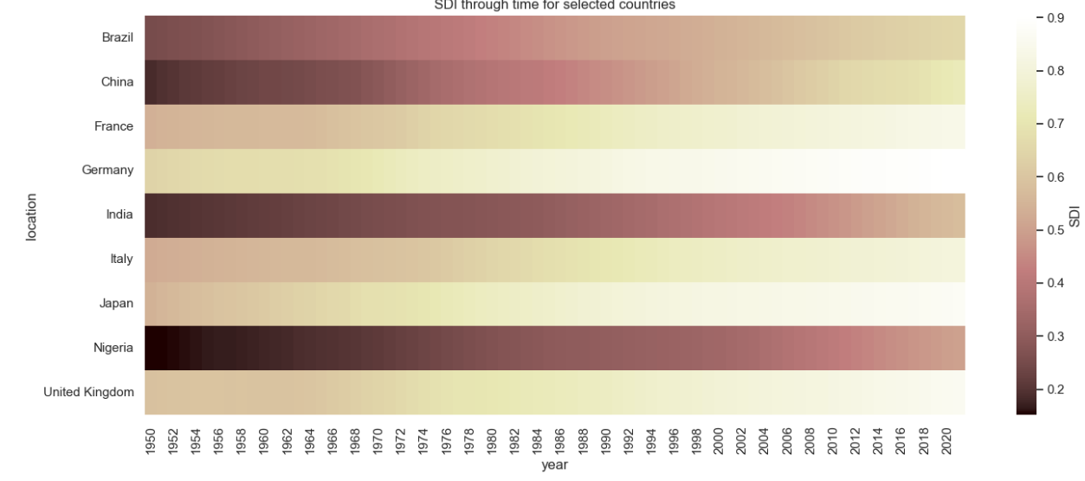
Long-Term SDI Evolution for Major Countries
The heatmap displays long-term SDI trajectories for ten major countries across different world regions. The color intensification over time reflects each country’s progress, revealing both convergence and divergence patterns
Early Stabilizers — Japan, Germany, UK
These countries reached high SDI levels early and remain consistently dark on the heatmap, indicating mature demographic and social systems.
Rapid Climbers — China, India, Brazil
Emerging giants (China, India, Brazil) show steady, strong improvements, particularly after the 1980s, signalling rapid socioeconomic transformations.
Slow Progresses — Nigeria and Others
Lower-SDI countries such as Nigeria display slower progress and remain lighter in color, indicating persistent development challenges
“SDI Heatmap for Selected Countries” by Abdul Sami, based on a dataset from the Institute for Health Metrics and Evaluation (IHME). Under the Free-of-Charge Non-Commercial User Agreement

Slide 11
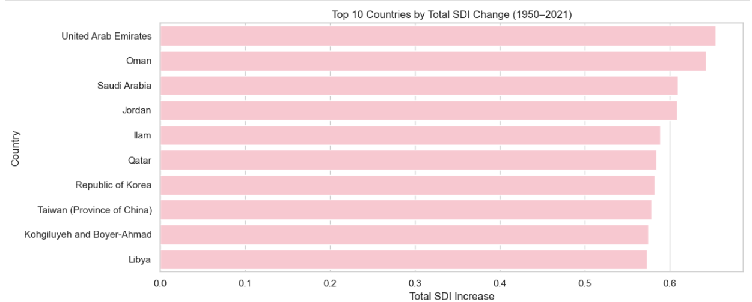
Top 10 Countries by Total SDI Change (1950–2021)
The bar chart displays the ten countries with the largest cumulative SDI increases from 1950 to 2021. Each bar represents the total sum of year-to-year SDI differences for that country, highlighting the nations that experienced the most significant long-term improvements.
Middle Eastern Surge — UAE, Oman, Saudi Arabia, Qatar
These countries show the most dramatic SDI increases, driven by rapid modernization and economic transformation.
Strategic Reformers — Jordan, Iran
Large improvements reflect demographic transition, education expansion, and healthcare system strengthening.
East Asian Risers — South Korea, Taiwan
Decades of industrialization and human-capital investment resulted in exceptional long-term SDI growth.
Overall, The biggest SDI improvements cluster in the Middle East and East Asia, highlighting two of the world’s fastest-transforming regions.
“Countries With the Largest Long-Term SDI Gains” by Abdul Sami, based on a dataset from the Institute for Health Metrics and Evaluation (IHME). Under the Free-of-Charge Non-Commercial User Agreement

Slide 12
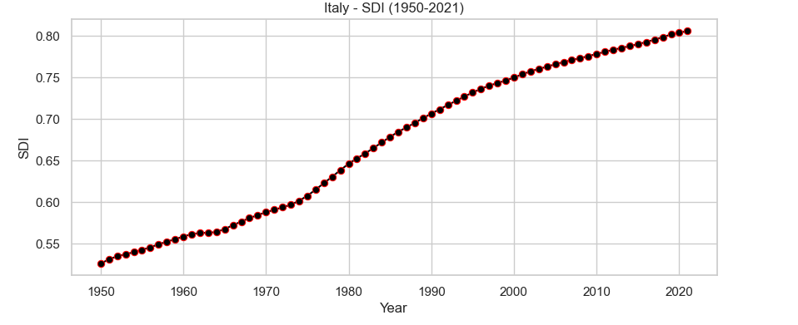
Italy’s Development Trajectory (1950–2021)
Italy’s SDI trajectory shows a long-term and almost uninterrupted improvement from 1950 onward The early decades reflect rapid post-war reconstruction, declining fertility, rising life expectancy, and expansion of public education.
Growth stabilizes around the 1980s–1990s as Italy completes its demographic transition and reaches high-SDI status.
From the 2000s onwards, improvements continue but at a slower pace, showing the typical plateau of developed countries where further gains become incremental
“Italy SDI Time Series (1950–2021)” by Abdul Sami, based on a dataset from the Institute for Health Metrics and Evaluation (IHME). Under the Free-of-Charge Non-Commercial User Agreement
Why chosen:A line chart clearly communicates long-term temporal change and highlights phases of acceleration,stabilization.

Slide 13
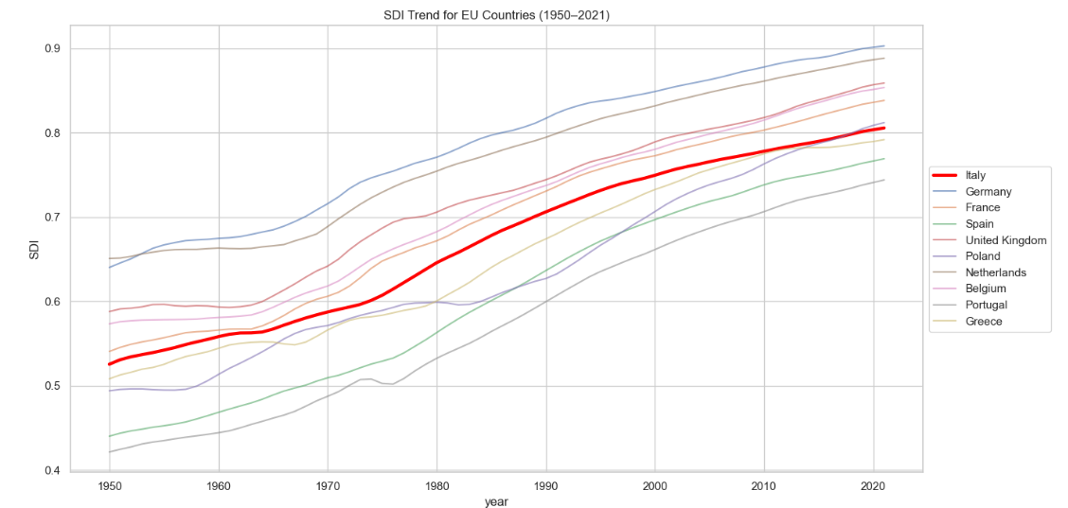
SDI Trend for EU Countries (1950–2021)
When comparing Italy to other European Union countries, the chart shows that Italy’s progression aligns closely with major Western European economies.
Older EU members exhibit similar long-term trajectories, with rapid development in the 1950–1980 period and stabilization afterward.
Eastern European countries show different dynamics: a slower pace during the communist era, followed by accelerated growth after 1990 and EU integration.
Italy stands consistently in the upper tier of EU SDI values, demonstrating a stable social framework comparable to Germany, France, and the UK.
Why chosen:
Multi-line charts allow direct comparison of development trajectories among countries sharing similar institutional and economic contexts.
“Italy vs EU Countries (1950–2021)” by Abdul Sami, based on a dataset from the Institute for Health Metrics and Evaluation (IHME).Under the Free-of-Charge Non-Commercial User Agreement

Slide 14
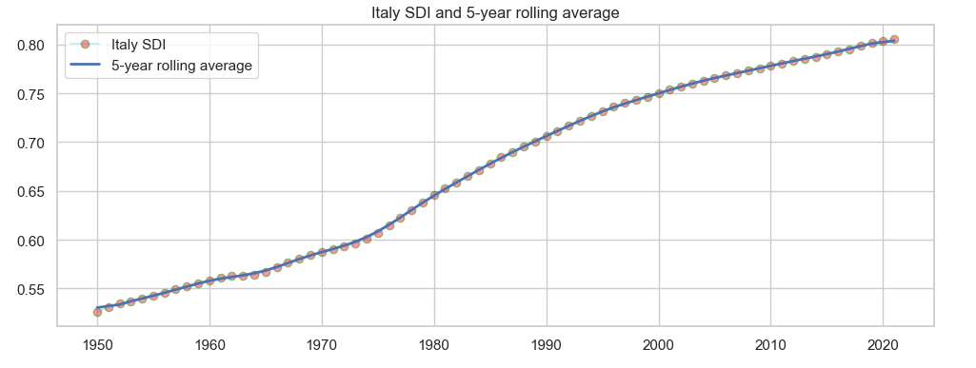
Italy Rolling Averages (5-year)
The rolling-average plot smooths year-to-year fluctuations to reveal the underlying long-term trend of Italy's SDI.
The 5-year moving average line clearly highlights Italy’s continuous upward progression while removing short-term irregularities caused by measurement noise or temporary demographic effects.
The curve shows periods of accelerated progress (1950–1975), followed by a stable transition phase (1980–2000), and a slow but steady rise toward the high-SDI plateau in the 21st century.
This smoothing emphasizes structural improvement in education, health, and demographic indicators.
Why chosen:A rolling average smooths short-term fluctuations, making the underlying long-term development trend easier to interpret.
“Italy SDI and 5-year rolling average” by Abdul Sami, based on a dataset from the Institute for Health Metrics and Evaluation (IHME). Under the Free-of-Charge Non-Commercial User Agreement

Slide 15
Italy SDI Forecast (ARIMA) to 2035
This analysis projects Italy’s SDI trajectory beyond observed data, offering an outlook up to 2035 using the ARIMA model.
The model captures the long-term pattern of Italy’s SDI, which has steadily increased over decades with no major disruptions. The forecast indicates that this gradual upward trend is likely to continue, reflecting the characteristics of a mature, high-income country where development improvements are incremental rather than rapid.
The projected curve follows the historical slope, showing no sharp acceleration or decline. This suggests that Italy’s demographic stability, high education levels, and robust healthcare system will continue to support steady development. While all forecasts carry uncertainty, the overall expectation is clear: Italy is likely to maintain moderate, sustainable SDI growth through the 2030s.
Italy’s SDI is projected to increase gradually in future decades.
The trend remains stable, without major expected downturns.
Confirms long-term resilience of Italy’s social development trajectory.
Why chosen: Time-series forecasting visualizations extend historical trends to support forward-looking interpretation and scenario reasoning.

Slide 16
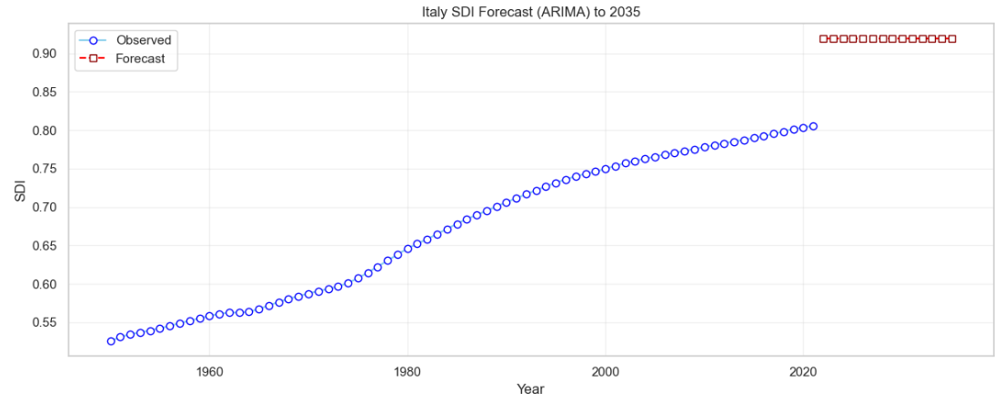

Slide 17
Italy SDI Rolling Averages (5-year, 10-year, 20-year)
This visualization compares Italy’s SDI using multiple smoothing windows to highlight long- and short-term developmental dynamics.
5-Year Window — Medium-Term Transitions
The 5-year rolling average captures medium-term fluctuations, revealing the transitional phases during Italy’s modernization.
10-Year Window — Structural Periods of Growth
The 10-year line provides a broader view, showing long-term phases of sustained growth, especially during the economic boom of the 1950s–1970s and the stabilization after the 1990s.
20-Year Window — Deep Structural Trends
The 20-year window smooths the series almost completely, showing the structural evolution of Italy’s development: rapid ascent from post-war conditions, gradual leveling, and slow upward drift in recent decades.
Together, these layers reveal how Italy’s SDI growth transitions from fast, transformative improvements to slow, sustained stability characteristic of advanced nations.
Italy’s fastest development occurred before 1980.
After 1990, growth becomes slower but stable.
Rolling windows highlight the shift from rapid modernization to long-term maturity.
Why Choose: Using multiple smoothing windows on a multi-line plot highlights short-term variations and long-term development trends across different series.

Slide 18
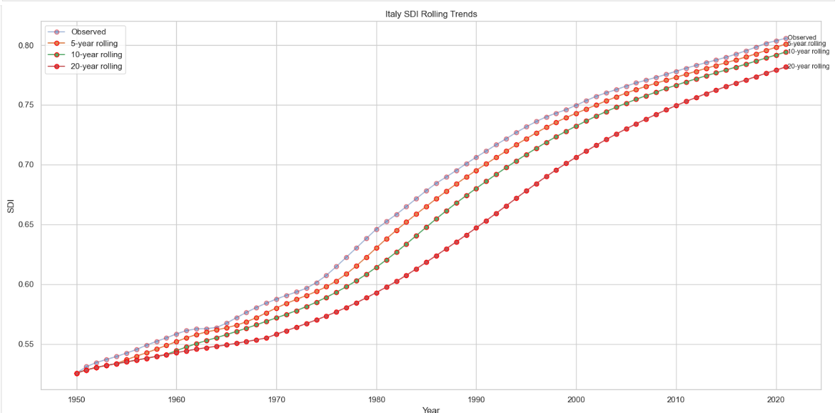

Slide 19
“Italy vs Selected Asian Countries — SDI (1950–2021)”
Italy Compared With Rapid-Growth Asian Economies
This comparison places Italy alongside major Asian economies (China, India,Pakistan, Bangladesh, Thailand, Malaysia, Singapore, Iran).Italy begins the period at a more developed state, reflecting early industrialization and post-war reconstruction.
Many Asian countries start at significantly lower SDI levels but experience rapid acceleration — particularly China, Iran, Malaysia, and Thailand — demonstrating sizable economic and demographic transformations.
By the 2000s, some countries narrow the gap substantially, while a few, for instance, Singapore overtook Italy, highlighting Asia’s dynamic development patterns.
Italy’s line is smoother and more stable, typical of a mature socio-demographic profile, whereas the Asian countries display more varied and sometimes dramatic upward trajectories.
Italy maintains high SDI levels consistently.
Several Asian countries show rapid catch-up, closing historical gaps.
Highlights contrasting development speeds across regions.
Why chosen: I Choice this Because The Multi-line plots allow direct comparison of development paths between countries.

Slide 20
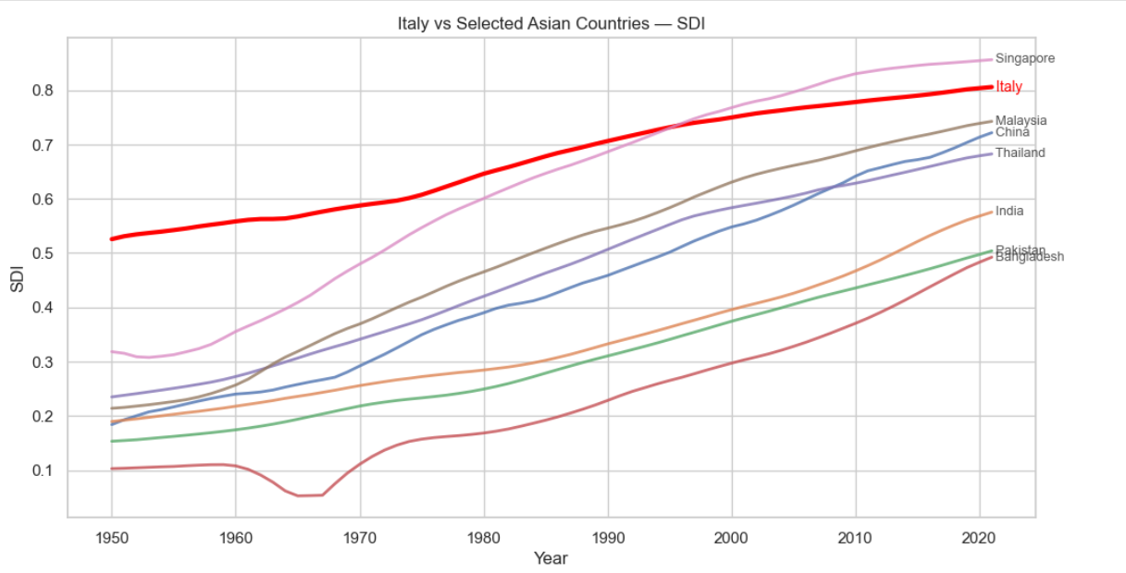

Slide 21
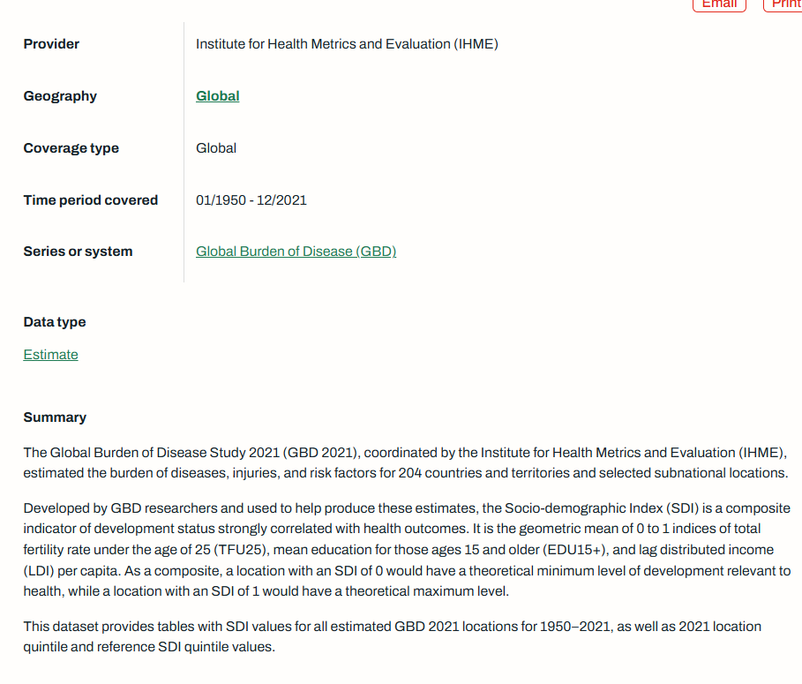
“From Global Burden of Diseaseto SDI Analysis: Socio-Demographic Index Trends (1950–2021)”
by Abdul Sami
Developed using data from the Institute for Health Metrics and Evaluation (IHME) Global Burden of Disease Study 2021 (GBD 2021), with charts and analyses produced in Python (Pandas, Matplotlib, Seaborn).
This material is distributed under a Creative Commons CC BY-NC-SA 4.0 license.
Data source: the Institute for Health Metrics and Evaluation (IHME). Under the Free-of-Charge Non-Commercial User Agreement
Global Burden of Disease Study 2021 (SDI) dataset Click
Project All Martial and Report(Github)

